Slide 1
Module 6: Creating a Networking Environment
AWS Academy Cloud Architecting
© 2020, Amazon Web Services, Inc. or its Affiliates. All rights reserved.
Notes:
Welcome to Module 6: Creating a Networking Environment.

Slide 2

Module overview
Sections
Architectural need
Creating an AWS networking environment
Connecting your AWS networking environment to the internet
Securing your AWS networking environment
Demonstration
Creating a Virtual Private Cloud
Labs
Guided Lab: Creating a Virtual Private Cloud
Challenge Lab: Creating a VPC Networking Environment for the Café
Knowledge check
Notes:
This module includes the following sections:
Architectural need
Creating an network environment
Connecting your network environment to the internet
Securing your network environment
The module also includes:
A demonstration that will show you how manually create a virtual private cloud (VPC)
A guided lab where you will create a VPC on your own
A challenge lab where you will create a VPC, enable private resources to connect to the internet, and create a security layer to control traffic to and from private resources in your VPC.
Finally, you will be asked to complete a knowledge check that will test your understanding of key concepts covered in this module.

Slide 3
Module objectives
At the end of this module, you should be able to:
Explain the foundational role of a virtual private cloud (VPC) in Amazon Web Services (AWS) Cloud networking
Identify how to connect your AWS networking environment to the internet
Describe how to isolate resources within your AWS networking environment
Create a VPC with subnets, an internet gateway, route tables, and a security group
Notes:
At the end of this module, you should be able to:
Explain the foundational role of a virtual private cloud (VPC) in Amazon Web Services (AWS) Cloud networking
Identify how to connect your AWS networking environment to the internet
Describe how to isolate resources within your AWS networking environment
Create a VPC with subnets, an internet gateway, route tables, and a security group

Slide 4
Section 1: Architectural need
Module 6: Creating a Networking Environment
Notes:
Introducing Section 1: Architectural need.

Slide 5
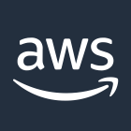

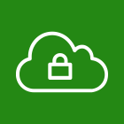
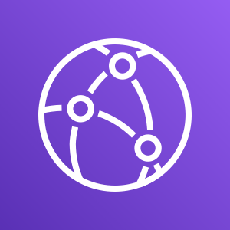



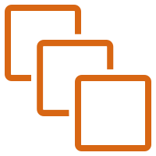

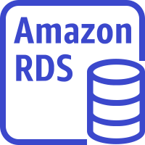
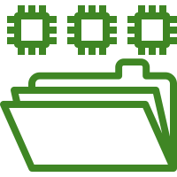
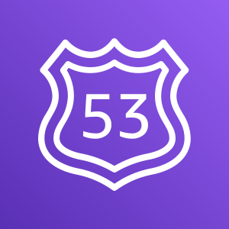

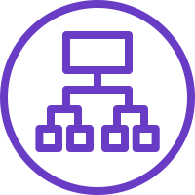
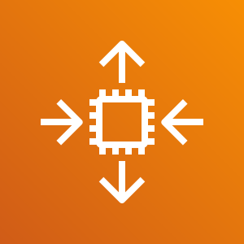
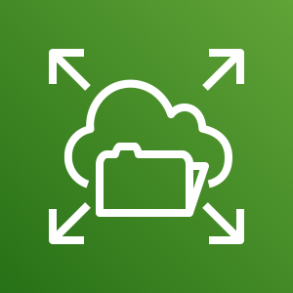


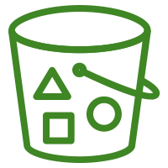
Networking as part of a larger architecture
Region
VPC
Public subnet
Private subnet
Private subnet
Amazon
CloudFront
Availability Zone 2
NAT gateway
EC2 instances
ElastiCache for Memcached
Amazon RDS standby instance
Amazon EFS mount target
Internet gateway
Application
Load Balancer
Amazon EC2 Auto Scaling
Amazon EFS
Amazon Route 53
Public subnet
Private subnet
Private subnet
Availability Zone 1
NAT gateway
EC2 instance
ElastiCache for Memcached
Amazon RDS primary instance
Amazon EFS mount target
Users
Static website on S3
Notes:
In this module, you will learn how to design a network on AWS and build a VPC with subnets. You will also learn how to connect instances in your public and private subnets to the internet.

Slide 6
Café business requirement
The café must deploy and manage AWS resources in a secure, isolated network environment.
Notes:
The café’s business has been steadily increasing. Sofía and Nikhil have become friends with a few of the café regulars, who are AWS consultants, and they have started to discuss the café’s current architecture. Olivia, one of the regulars and an AWS Solutions Architect, identified a need for the café’s online business to scale. Scaling will require additional servers to run the online ordering application, but the current subnet size is too small and can’t support this growth. Therefore, they will need to rearchitect some aspects of the network that the application runs in.
On further review of the café’s architecture, Olivia also noticed a vulnerability: the TCP port that’s used to administer the application server is accessible to the internet. Sofía explained that she and Nikhil must be able to manage and maintain the server. Olivia advises them to set up a bastion host to reduce public access to the server, and to make it more secure.

Slide 7
Section 2: Creating an AWS networking environment
Module 6: Creating a Networking Environment
Notes:
Introducing Section 2: Creating an AWS networking environment.

Slide 8
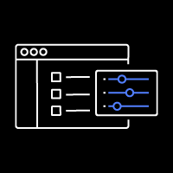
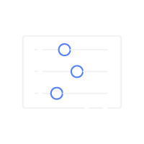
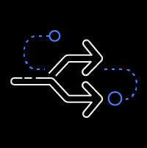

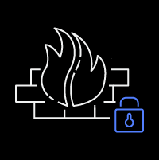
Amazon VPC
Provision a logically isolated section of the AWS Cloud where you can launch AWS resources in a virtual network that you define.
Bring your own network
IP Addresses
Subnets
Routing rules
Network configuration
Security rules
Notes:
Amazon Virtual Private Cloud (Amazon VPC) is a service that enables you to provision a logically isolated section of the AWS Cloud (called a virtual private cloud, or VPC) where you can launch your AWS resources.
Amazon VPC gives you control over your virtual networking resources. For example, you can select your own IP address range, create subnets, and configure route tables and network gateways. You can use both IPv4 and IPv6 in your VPC for secure access to resources and applications.
You can also customize the network configuration for your VPC. For example, you can create a public subnet for your web servers that can access the public internet. You can place your backend systems (such as databases or application servers) in a private subnet with no public internet access.
Finally, you can use multiple layers of security to help control access to Amazon Elastic Compute Cloud (Amazon EC2) instances in each subnet. These security layers include security groups and network access control lists (network ACLs).

Slide 9
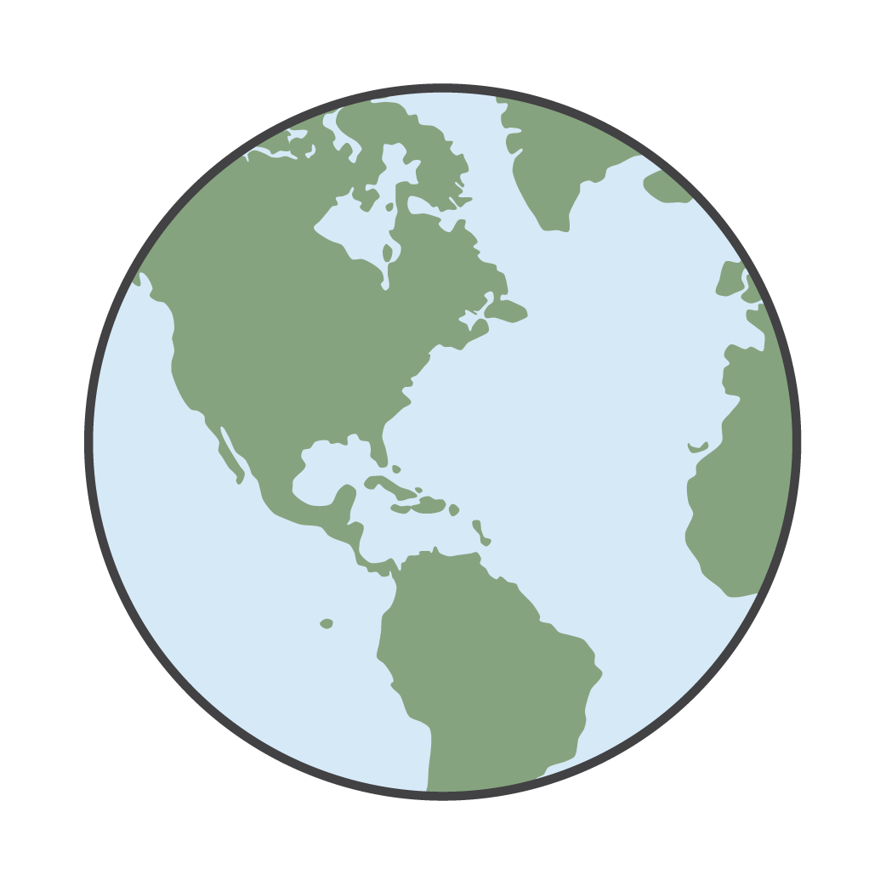
VPC deployment
Region
VPC
Availability Zone A
Availability Zone B
VPC
Availability Zone C
You can deploy a VPC in any AWS Region.
A VPC can host supported resources from any Availability Zone within its Region.
Notes:
A VPC belongs to a single AWS Region. A VPC spans all the Availability Zones in a Region, so it can host supported resources from any Availability Zone within its Region.

Slide 10
Classless Inter-Domain Routing (CIDR)
CIDR | Total IP addresses
/28 | 16
… | …
/20 | 4,096
/19 | 8,192
/18 | 16,384
/17 | 32,768
/16 | 65,536
0.0.0.0/0
10.22.33.44/32
10.22.33.0/24
10.22.0.0/16
= All IP addresses
= 10.22.33.44
= 10.22.33.*
= 10.22.*.*
Notes:
When you create a VPC, you provide the set of private IP addresses that you want instances in your VPC to use. You specify this set of addresses as a Classless Inter-Domain Routing (CIDR) block—for example, 10.0.0.0/16. This is the primary CIDR block for your VPC. You can assign block sizes of between /28 (16 IP addresses) and /16 (65,536 IP addresses).
Amazon VPC supports IPv4 and IPv6 addressing and has different CIDR block size limits for each. By default, all VPCs and subnets must have IPv4 CIDR blocks—you can't change this behavior. You can optionally associate an IPv6 CIDR block with your VPC.
Your VPC can operate in dual-stack mode: your resources can communicate over IPv4, or IPv6, or both. IPv4 and IPv6 addresses are independent of each other, so you must configure routing and security in your VPC separately for IPv4 and IPv6.

Slide 11
Subnets: Dividing your VPC
A subnet is a segment or partition of a VPC’s IP address range where you can allocate a group of resources
Subnets are not isolation boundaries
Subnets are a subset of the VPC CIDR block
Subnet CIDR blocks cannot overlap
Each subnet resides entirely within one Availability Zone
You can add one or more subnets in each Availability Zone or in a Local Zone
AWS reserves five IP addresses in each subnet
Availability Zone
Availability Zone
VPC: 10.0.0.0/22
Public subnet
Public subnet
10.0.0.0/24
251 IP addresses
10.0.2.0/24 251 IP addresses
Private subnet
Private subnet
10.0.1.0/24 251 IP addresses
10.0.3.0/24 251 IP addresses
Example: A VPC with CIDR /22 includes 1,024 total IP addresses.
Notes:
You can divide a VPC into one or more subnets. A subnet is a segment or partition of a VPC’s IP address range where you can allocate a group of resources. It is important to remember that subnets are not isolation boundaries around your application. Instead, they are containers for routing policies, which you will learn about in the next section of this module.
When you create a subnet, you specify the CIDR block for the subnet, which is a subset of the VPC CIDR block. Subnet CIDR blocks cannot overlap.
Though each subnet must reside entirely within one Availability Zone and cannot span zones, each Availability Zone can have one or more subnets. You can optionally add subnets in a Local Zone. When you create a subnet in a Local Zone, the VPC is also extended to that Local Zone. For more information about how to extend your VPC resources to a Local Zone, see Extending Your VPC Resources to AWS Local Zones in the AWS Documentation.
Because VPC subnets are mapped to specific Availability Zones, subnet placement is one way to ensure that Amazon EC2 instances are properly distributed across multiple locations.
AWS reserves the first four IP addresses and the last IP address in each subnet CIDR block. For example, in a subnet with CIDR block 10.0.0.0/24, AWS reserves the following five IP addresses for:
10.0.0.0: Network address
10.0.0.1: VPC local router
10.0.0.2: Domain Name System (DNS) resolution
10.0.0.3: Future use
10.0.0.255: Network broadcast address
For more information about VPCs and subnets, see VPCs and Subnets in the AWS Documentation.

Slide 12
VPC design best practices
Create one subnet per available Availability Zone for each group of hosts that have unique routing requirements.
Divide your VPC network range evenly across all available Availability Zones in a Region.
Do not allocate all network addresses at once. Instead, ensure that you reserve some address space for future use.
Size your VPC CIDR and subnets to support significant growth for the expected workloads.
Ensure that your VPC network range (CIDR block) does not overlap with your organization’s other private network ranges.
Notes:
When you configure any computer network, consider the following universal network design principles:
Create one subnet per available Availability Zone for each group of hosts that have unique routing requirements.
Divide your VPC network range evenly across all available Availability Zones in a Region.
Do not allocate all network addresses at once. Instead, ensure that you reserve some address space for future use.
Size your VPC CIDR and subnets to support significant growth for the expected workloads.
Ensure that your VPC network range (CIDR block) does not overlap with your organization’s other private network ranges.
For more information about designing and sizing individual VPCs, see AWS Single VPC Design.

Slide 13
Single VPC deployment
There are limited use cases where deploying one VPC might be appropriate:
Small, single applications managed by a small team
High performance computing (HPC)
Identity management
For most use cases, there are two primary patterns for organizing your infrastructure: multi-VPC and multi-account.
Notes:
When you design and create your network environment, there are a limited number of use cases where a single VPC environment might be appropriate:
Small, single applications managed by a small team
High performance computing (HPC) environments (such as physics simulations)—a single VPC environment has lower latency than one spread across multiple VPCs
Identity management environments—a single VPC might provide best security.
For most use cases, however, a multi-VPC environment is required. You can create multiple VPCs within the same Region or in different Regions. You can also create multiple VPCs in the same AWS account or in different AWS accounts.

Slide 14
Multiple VPCs
Best suited for –
Single team or single organizations, such as managed service providers
Limited teams, which makes it easier to maintain standards and manage access
Exception –
Governance and compliance standards might require greater workload isolation regardless of organizational complexity
AWS Cloud
VPC
VPC
VPC
VPC
Notes:
Multiple VPCs are best suited for a single team or organization that maintains full control over the provisioning and management of all resources in each application environment. For example, consider a single team that develops a large ecommerce application. They might use this pattern when the developers have full access to the Development and Production environments. This pattern is also common with managed service providers (MSPs) that manage all resources in Test and Production environments.
To learn more about services and best practices for multiple-VPC deployments, see:
Single Region Multi-VPC Connectivity
Multiple Region Multi-VPC Connectivity

Slide 15
Multiple accounts
Best suited for –
Large organizations and organizations with multiple IT teams
Medium-sized organizations that anticipate rapid growth
Why?
It can be more challenging to manage access and standards in more complex organizations
AWS Cloud
AWS Cloud
AWS Cloud
AWS Cloud
VPC
VPC
VPC
VPC
Notes:
As mentioned, you can create multiple VPCs in the same AWS account or in different accounts.
Multiple-account patterns are best suited for enterprise customers or organizations that deploy applications managed across multiple teams. For example, consider an organization that supports two or more teams. They might use this pattern to support developers who have full access to Development environment resources, but limited or no access to the Production environment.

Slide 16
Amazon VPC quotas
Default quota: 5 VPCs per Region per account *
AWS Cloud
Region
* The default quota is 5 VPCs per Region, but you can request a quota increase.
Notes:
Be aware of Amazon VPC quotas. The default quota is 5 VPCs per Region. However, you can request an increase for this quota.
For more information about Amazon VPC service limits, see Amazon VPC quotas in the AWS Documentation.

Slide 17

Section 2 key takeaways
Amazon VPC enables you to provision VPCs, which are logically isolated sections of the AWS Cloud where you can launch your AWS resources.
A VPC belongs to only one Region and is divided into subnets.
A subnet belongs to one Availability Zone or Local Zone. It is a subset of the VPC CIDR block.
You can create multiple VPCs in the same Region or in different Regions, and in the same account or different accounts.
Follow best practices when you design your VPC.
Notes:
Some key takeaways from this section of the module include:
Amazon VPC enables you to provision VPCs, which are logically isolated sections of the AWS Cloud where you can launch your AWS resources.
A VPC belongs to only one Region and is divided into subnets.
A subnet belongs to one Availability Zone or Local Zone. It is a subset of the VPC CIDR block.
You can create multiple VPCs within the same Region or in different Regions, and in the same account or different accounts.
Follow these best practices when designing your VPC –
Create one subnet per Availability Zone for each group of hosts that have unique routing requirements.
Divide your VPC network range evenly across all available Availability Zones in a Region.
Do not allocate all network addresses at once. Instead, ensure that you reserve some address space for future use.
Size your VPC CIDR and subnets to support significant growth for the expected workloads.
Ensure that your VPC network range does not overlap with your organization’s other private network ranges.

Slide 18
Section 3: Connecting your AWS networking environment to the internet
Module 6: Creating a Networking Environment
Notes:
Introducing Section 3: Connecting your AWS networking environment to the internet.

Slide 19
Creating a public subnet
Internet gateways
Users
Allow communication between resources in your VPC and the internet
Are horizontally scaled, redundant, and highly available by default
Provide a target in your subnet route tables for internet-routable traffic
Internet gateway <igw-id>
VPC: 10.0.0.0/16
Public subnet: 10.0.0.0/24
EC2 instance:
Private IP address – 10.0.0.5
Public IP address – 198.51.100.2
Notes:
Now that you know how to design and create an isolated network environment for your workloads, you will want to connect it to the internet.
An internet gateway is a VPC component that allows communication between resources in your VPC and the internet. It is horizontally scaled, redundant, and highly available. An internet gateway supports IPv4 and IPv6 traffic. An internet gateway serves two purposes. First, it provides a target in your VPC route tables for internet-routable traffic. Second, the internet gateway performs network address translation (NAT) for instances that were assigned public IPv4 addresses.
To make a subnet public, you must first create an internet gateway and attach it to your VPC.

Slide 20
Directing traffic between VPC resources
Route tables are required to direct traffic between VPC resources
Each VPC has a main (default) route table
All subnets must be associated with a route table
You can create custom route tables
Best practice: Use custom route tables for each subnet.
Internet gateway <igw-id>
VPC: 10.0.0.0/16
Public subnet: 10.0.0.0/24
EC2 instance:
Private IP address – 10.0.0.5
Public IP address – 198.51.100.2
Public route table
Destination | Target
10.0.0.0/16 | local
0.0.0.0/0 | <igw-id>
Notes:
Next, you must update the route table associated with the subnet you want to connect to the internet. A route table contains a set of rules, called routes. Routes are used to determine where network traffic is directed.
When you create a VPC, it automatically has a main route table. Initially, the main route table (and every route table in a VPC) contains only a single local route that enables communication for all the resources in the VPC. You can't modify the local route in a route table. When you launch an instance in the VPC, the local route automatically covers that instance. You don't need to add the new instance to a route table. You can create additional custom route tables for your VPC.
Each subnet in your VPC must be associated with a route table, which controls the routing for the subnet. If you don't explicitly associate a subnet with a particular route table, the subnet is implicitly associated with and uses the main route table. A subnet can be associated with only one route table at a time, but you can associate multiple subnets with the same route table.
You can create custom route tables for each subnet to enable granular routing for destinations.
To send non-local traffic through the internet gateway to the internet, create a route with destination 0.0.0.0/0 and target <igw-id> in the route table associated with the subnet.

Slide 21

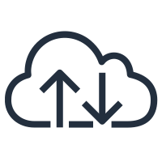
Remapping an IP address from one instance to another
Elastic IP addresses
Internet
Internet gateway <igw-id>
Are static, public IPv4 addresses associated with your AWS account
Can be associated with an instance or elastic network interface
Can be remapped to another instance in your account
Are useful for redundancy when load balancers are not an option
VPC: 10.0.0.0/16
Public subnet: 10.0.10.0/24
Private IP address: 10.0.10.5 Elastic IP address: 198.51.100.2
Private IP address: 10.0.10.6 Elastic IP address: 198.51.100.2
Private subnet: 10.0.20.0/24
EC2 instance: Private IP address – 10.0.20.5
Notes:
Next, you must make sure that your instances have either public IP or Elastic IP addresses.
An Elastic IP address is a static and public IPv4 address that is designed for dynamic cloud computing. You can associate an Elastic IP address with any instance or elastic network interface for any VPC in your account. With an Elastic IP address, you can mask the failure of an instance by rapidly remapping the address to another instance in your VPC. Associating the Elastic IP address with the network interface has an advantage over associating it directly with the instance. You can move all of the attributes of the network interface from one instance to another in a single step.

Slide 22
Connecting private subnets to the internet
Users
NAT gateways
Public route table
Internet gateway <igw-id>
Enable instances in a private subnet to initiate outbound traffic to the internet or other AWS services
Prevent private instances from receiving inbound connection requests from the internet
Destination | Target
10.0.0.0/16 | local
0.0.0.0/0 | <igw-id>
VPC: 10.0.0.0/16
Public subnet: 10.0.10.0/24
NAT gateway <nat-id>
Private route table
Destination | Target
10.0.0.0/16 | local
0.0.0.0/0 | <nat-id>
Private subnet: 10.0.20.0/24
EC2 instance: Private IP address – 10.0.20.5
Notes:
To connect instances in your private subnet to the internet or other AWS services, you need a network address translation (NAT) gateway. A NAT gateway enables instances in a private subnet to connect to the internet or other AWS services, but prevents the internet from initiating a connection with those instances.
To create a NAT gateway, you must specify the public subnet where the NAT gateway should reside. You must also specify an Elastic IP address to associate with the NAT gateway. After you create a NAT gateway, you must update the route table that is associated with one or more of your private subnets to point internet-bound traffic to the NAT gateway. Thus, instances in your private subnets can communicate with the internet.

Slide 23


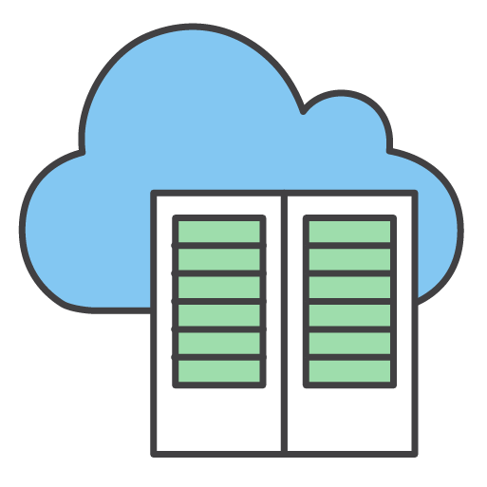
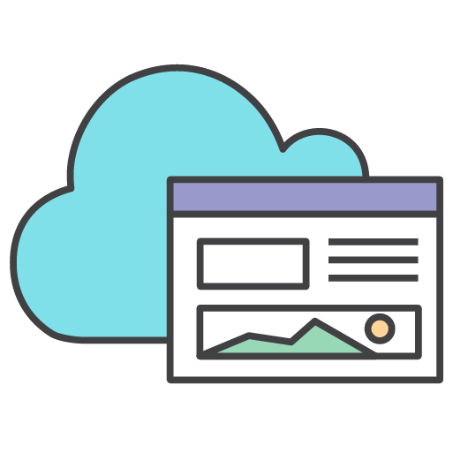
Subnet use case examples (1 of 2)
Data store instances
Batch-processing instances
Backend instances
Web application instances
Notes:
Take a moment to think about whether the instances in these examples should be put into a public or private subnet.

Slide 24
Subnet use case examples (2 of 2)
Data store instances
Private subnet
Batch-processing instances
Private subnet
Backend instances
Private subnet
Web application instances
Public or private subnet
Notes:
Data store instances, batch-processing instances, and backend instances should be put into private subnets. You can put web-tier instances into a public subnet. However, AWS recommends that you put web-tier instances inside private subnets behind a load balancer that is placed in a public subnet. In some environments, you must attach web application instances to Elastic IP addresses directly (though you can also attach an Elastic IP address to a load balancer). In those cases, web application instances must be in a public subnet.

Slide 25
Bastion hosts
A server whose purpose is to provide access to a private network from an external network
Must minimize the chances of penetration
VPC
Public subnet
Private subnet
Security group
Security group
Bastion host users
Bastion host
EC2 instances
Notes:
A bastion host is a server that provides access to a private network from an external network, such as the internet. You can use a bastion host to minimize the chances of penetration and potential attack on resources in your private network.
For example, suppose you want to allow connections from an external network to Linux instances in a private subnet of your VPC via Secure Shell, or SSH.
You can use a bastion host to mitigate the risk of allowing these external SSH connections to the instances in the private subnet. A bastion host typically runs on an EC2 instance in a public subnet of your VPC, as shown in this example. The Linux instances in the private subnet are in a security group that allows SSH access from the security group attached to the bastion host. Bastion host users connect to the bastion host so they can connect to the Linux instances.
Though you can adapt this architecture to meet your own requirements, the bastion host should be the only source of SSH traffic to your Linux instances.
For more information about this architecture, see the blog post How to Record SSH Sessions Established Through a Bastion Host. To learn how to deploy a Linux bastion host in a VPC environment on AWS, complete this Linux Bastion Hosts on AWS Quick Start.

Slide 26
Demonstration: Creating a Virtual Private Cloud
Notes:
Now, your educator might choose to demonstrate how to use Amazon VPC to manually create a VPC with subnets, an internet gateway, and a route table.

Slide 27
Section 3 key takeaways
An internet gateway allows communication between instances in your VPC and the internet.
Route tables control traffic from your subnet or gateway.
Elastic IP addresses are static, public IPv4 addresses that can be associated with an instance or elastic network interface. They can be remapped to another instance in your account.
NAT gateways enable instances in the private subnet to initiate outbound traffic to the internet or other AWS services.
A bastion host is a server whose purpose is to provide access to a private network from an external network, such as the internet.
Notes:
Some key takeaways from this section of the module include:
An internet gateway allows communication between instances in your VPC and the internet.
Route tables control traffic from your subnet or gateway.
Elastic IP addresses are static, public IPv4 addresses that can be associated with an instance or elastic network interface. They can be remapped to another instance in your account.
NAT gateways enable instances in the private subnet to initiate outbound traffic to the internet or other AWS services.
A bastion host is a server whose purpose is to provide access to a private network from an external network, such as the internet.

Slide 28
Section 4: Securing your AWS networking environment
Module 6: Creating a Networking Environment
Notes:
Introducing Section 4: Securing your AWS networking environment.

Slide 29
Security groups
Are stateful firewalls that control inbound and outbound traffic to AWS resources
Act at the level of the instance or network interface
VPC
Public subnet
Security group
Security group
Notes:
Now that you know how to design and deploy a network environment, and connect it to the internet, you must isolate your applications and workloads.
You can achieve isolation by deploying the EC2 instances that host your application or workload into a security group that is attached to your VPC.
Security groups are stateful firewalls that act at the level of instance or network interface.
Stateful means that return traffic is allowed is automatically allowed, regardless of any rules. For example, say that you initiate an Internet Control Message Protocol (ICMP) ping command to your instance from your home computer. If your inbound security group rules allow ICMP traffic, information about the connection (including the port information) is tracked. Response traffic from the instance for the ping command is not tracked as a new request. Instead, it is tracked as an established connection. It is allowed to flow out of the instance, even if your outbound security group rules restrict outbound ICMP traffic.
Security group rules control inbound and outbound traffic to your AWS resources. You should tightly configure these rules to restrict traffic and allow access only as needed. Traffic can be restricted by any internet protocol, service port, and source or destination IP address (individual IP address or CIDR block).
Not all traffic flows are tracked. Consider a security group rule that permits transmission control protocol (TCP) or user datagram protocol (UDP) flows for all traffic (that is, 0.0.0.0/0). There is also a corresponding rule in the other direction that permits the response traffic. In this case, that flow of traffic is not tracked. The response traffic is therefore allowed to flow based on the inbound or outbound rule that permits the response traffic, and not on tracking information.

Slide 30
Default security groups
Block all
inbound traffic
Allow all
outbound traffic
Security group
Security group
Notes:
When you create a security group, it has no inbound rules. This means that you must add inbound rules to the security group to allow inbound traffic that originates from another host to your instance. By default, a security group includes an outbound rule that allows all outbound traffic. You can remove the rule and add outbound rules that allow specific outbound traffic only. If your security group has no outbound rules, no outbound traffic that originates from your instance is allowed.

Slide 31
Custom security groups
Internet gateway <igw-id>
VPC: 10.0.0.0/16
Public subnet: 10.0.0.0/24
Security group
EC2 instance:
Private IP address: 10.0.0.5
Public IP address: 198.51.100.2
Inbound
Type | Protocol | Port Range | Source | Destination
HTTP | TCP | 80 | Anywhere | Allow web access
Notes:
When you create a custom security group, you can specify allow rules, but not deny rules. For example, when you create a public subnet for the instances that host your web application, the last step is to create a security group that allows HTTP traffic to those instances.
All rules are evaluated before the decision to allow traffic is made.

Slide 32
Chaining security groups
Inbound rules
Allow: HTTP (port 80) or HTTPS (port 443)
Source: 0.0.0.0/0 (any)
Allow: SSH (port 22) to Web tier
Source: Corporate IP range
Web tier security group
Inbound rule
Allow: HTTP (port 8000) (application specific)
Source: Web tier
Application tier security group
Inbound rule
Allow: SSH (port 22) to Application tier Source: Corporate IP range
Inbound rule
Allow: TCP port 3306
Source: Application tier
Database tier security group
Inbound rule
Allow: SSH (port 22) to Database tier Source: Corporate IP range
All other ports blocked by default
Notes:
Most cloud organizations create security groups with inbound rules for each functional tier. This example shows a chain of security groups in a typical three-tier application. The inbound and outbound rules are set up so that traffic can only flow from the top tier to the bottom tier, and back up again. The security groups act as firewalls to prevent a security breach in one tier from automatically providing subnet-wide access of all resources to the compromised client.
Security groups can be configured to set different rules for different classes of instances. Consider this example of a traditional three-tier architecture for a web application. The group for the web servers would have port 80 (HTTP) or port 443 (HTTPS) open to the internet. The group for the application servers would have port 8000 (application-specific) accessible only to the web server group. The group for the database servers would have port 3306 (MySQL) open only to the application server group. All three groups would permit administrative access on port 22 (SSH), but only from the customer’s corporate network. This mechanism enables the deployment of highly secure applications.

Slide 33

Network access control lists (network ACLs)
Act at the subnet level
Allow all inbound and outbound traffic by default
Are stateless firewalls that require explicit rules for both inbound and outbound traffic
VPC
Public subnet
Network ACL
Notes:
A network access control list (network ACL) is an optional layer of security for your VPC. It acts as a firewall for controlling traffic in and out of one or more subnets. To add another layer of security to your VPC, you can set up network ACLs with rules that are similar to your security groups.
Each subnet in your VPC must be associated with a network ACL. If you don't explicitly associate a subnet with a network ACL, the subnet is automatically associated with the default network ACL. You can associate a network ACL with multiple subnets. However, a subnet can be associated with only one network ACL at a time. When you associate a network ACL with a subnet, the previous association is removed.
A network ACL has separate inbound and outbound rules, and each rule can either allow or deny traffic. Your VPC automatically comes with a modifiable default network ACL. By default, it allows all inbound and outbound IPv4 traffic and, if applicable, IPv6 traffic.
Network ACLs are stateless, which means that no information about a request is maintained after a request is processed. Return traffic must be explicitly allowed by rules.

Slide 34
Custom network ACLs
Recommended for
specific network security requirements only
Nacl-11223344
Inbound:
Rules # 100: SSH 172.31.1.2/32 ALLOW
Rules # *: ALL traffic 0.0.0.0/0 DENY
Outbound:
Rules # 100: Custom TCP 172.31.1.2/31 ALLOW
Rules # *: All traffic 0.0.0.0/0 DENY
VPC
Public subnet
Notes:
You can create a custom network ACL and associate it with a subnet. By default, each custom network ACL denies all inbound and outbound traffic until you add rules.

Slide 35
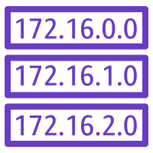
Structure your infrastructure with multiple layers of defense
VPC: 10.1.0.0/16
Security group
Subnet: 10.1.1.0/24
EC2 instance 10.1.1.6
Security group
Internet gateway
Route table
Network ACL
EC2 instance 10.1.1.7
Notes:
As a best practice, you should secure your infrastructure with multiple layers of defense. By running your infrastructure in a VPC, you can control which instances are exposed to the internet. You can define both security groups and network ACLs to further protect your infrastructure at the infrastructure and subnet levels, respectively. Additionally, you should secure your instances with a firewall at the operating system level, and follow other security best practices.
When you implement both network ACLs and security groups as a defense-in-depth way of controlling traffic, a mistake in the configuration of one of these controls will not expose the host to unwanted traffic.

Slide 36
Review: How to create a public subnet
To create a public subnet to allow communication between instances in your VPC and the internet, you must:
Destination | Target
10.0.0.0/16 | local
0.0.0.0/0 | <igw-id>
Security group
Attach an
internet gateway
to your VPC.
Point your instance subnet’s
route table
to the internet gateway.
Make sure that your instances have public IP or Elastic IP addresses.
Make sure that your
security groups and network ACLs allow relevant traffic to flow.
Notes:
To review, to create a public subnet to allow communication between instances in your VPC and the internet, you must:
Attach an internet gateway to your VPC
Add a route to your subnet’s route table that directs internet-bound traffic to the internet gateway
Make sure that your instances have public IP or Elastic IP addresses
Make sure that your security groups and network ACLs allow relevant traffic to flow

Slide 37
Section 4 key takeaways
Security groups are stateful firewalls that act at the instance level
Network ACLs are stateless firewalls that act at the subnet level
When you set inbound and outbound rules to allow traffic to flow from the top tier to the bottom tier of your architecture, you can chain security groups together to isolate a security breach
You should structure your infrastructure with multiple layers of defense
Notes:
Some key takeaways from this section of the module include:
Security groups are stateful firewalls that act at the instance level
Network ACLs are stateless firewalls that act at the subgroup level
When you set inbound and outbound rules to allow traffic to flow from the top tier to the bottom tier of your architecture, you can chain security groups together to isolate a security breach
You should structure your infrastructure with multiple layers of defense

Slide 38

Module 6 - Guided Lab: Creating a Virtual Private Cloud
Notes:
You will now complete Module 6 – Guided Lab: Creating a Virtual Private Cloud.

Slide 39
Guided lab: Tasks
Use Amazon VPC to manually create a VPC with:
Public and private subnets
An internet gateway
A route table with a route to direct internet-bound traffic to the internet gateway
A security group for EC2 instances in the public subnet
An application server to test the VPC
Notes:
In this lab, you will use Amazon VPC to manually create a VPC with the following components:
Public and private subnets
An internet gateway
A route table with a route to direct internet-bound traffic to the internet gateway
A security group for EC2 instances in the public subnet
An application server to test the VPC

Slide 40
Guided lab: Final product
Internet
AWS Cloud
Availability Zone
Internet gateway
Lab VPC: 10.0.0.0/16
Public subnet: 10.0.0.0/24
Security group
Application server
Private subnet: 10.0.2.0/23
Notes:
The diagram summarizes what you will have built after you complete the lab.

Slide 41


Begin Module 6 – Guided Lab: Creating a Virtual Private Cloud
~ 30 minutes
Notes:
It is now time to start the guided lab.

Slide 42
Guided lab debrief: Key takeaways
Notes:
Your educator might choose to lead a conversation about the key takeaways from this guided lab after you have completed it.

Slide 43

Module 6 – Challenge Lab: Creating a VPC Networking Environment for the Café
Notes:
You will now complete Module 6 – Challenge Lab: Creating a VPC Networking Environment for the Café.

Slide 44


The business need: A secure networking environment
Sofía and Nikhil separated the café’s database layer from the web application layer. They also moved the database resources from a public subnet to a private subnet.
Mateo advises them to enhance security by running the café’s application server in a private subnet that is separate from the database instance.
Notes:
Sofía and Nikhil have successfully created a two-tier architecture, in which they separated the café’s database layer from the web application layer. They also moved their database resources from a public subnet to a private subnet.
Mateo advises them to enhance the security of their VPC by running the café’s application server in a private subnet that is separate from the database instance.

Slide 45
Challenge lab: Tasks
Creating a public subnet
Creating a bastion host
Allocating an Elastic IP address for the bastion host
Testing the connection to the bastion host
Creating a private subnet
Creating a NAT gateway
Creating an EC2 instance in a private subnet
Configuring your SSH client for SSH passthrough
Testing the SSH connection from the bastion host
Creating a network ACL
Testing your custom network ACL
Notes:
In this challenge lab, you will complete the following tasks:
Creating a public subnet
Creating a bastion host
Allocating an Elastic IP address for the bastion host
Testing the connection to the bastion host
Creating a private subnet
Creating a NAT gateway
Creating an EC2 instance in a private subnet
Configuring your SSH client for SSH passthrough
Testing the SSH connection from the bastion host
Creating a network ACL
Testing your custom network ACL

Slide 46
Challenge lab: Final product
Lab VPC: 10.0.0.0/16
Public subnet: 10.0.0.0/24
Security group
Security group
NAT gateway
Bastion host
Test instance
Default Network ACL
Internet gateway
Custom Network ACL
Private subnet: 10.0.1.0/24
Security group
EC2 instance
Notes:
The diagram summarizes what you will have built after you complete the lab.

Slide 47
Begin Module 6 – Challenge Lab: Creating a VPC Networking Environment for the Café
~ 90 minutes
Notes:
It is now time to start the challenge lab.

Slide 48
Challenge lab debrief: Key takeaways
Notes:
Your educator might choose to lead a conversation about the key takeaways from this challenge lab after you have completed it.

Slide 49
Module wrap-up
Module 6: Creating a Networking Environment
Notes:
It’s now time to review the module and wrap up with a knowledge check and discussion of a practice certification exam question.

Slide 50
Module summary
In summary, in this module, you learned how to:
Explain the foundational role of VPC in AWS Cloud networking
Identify how to connect your AWS networking environment to the internet
Describe how to isolate resources within your AWS networking environment
Create a VPC with subnets, an internet gateway, route tables, and a security group
Notes:
In summary, in this module, you learned how to:
Explain the foundational role of a VPC in AWS Cloud networking
Identify how to connect your AWS networking environment to the internet
Describe how to isolate resources within your AWS networking environment
Create a VPC with subnets, an internet gateway, route tables, and a security group

Slide 51
Complete the knowledge check
Notes:
It is now time to complete the knowledge check for this module.

Slide 52
Sample exam question
You have an application running on multiple Amazon Elastic Compute Cloud (Amazon EC2) instances in a single Availability Zone. The application calls a third-party application programming interface (API) via the internet.
How can you provide the third-party API with a single IP address to add to an access safelist?
Assign an Elastic IP address to the instances.
Assign a public IP address to the instances.
Put the instances behind a NAT gateway.
Put the instances behind a Network Load Balancer.
Notes:
Consider at the answer choices and rule them out based on the keywords that were previously highlighted.
The correct answer is C: “Put the instances behind a NAT gateway.” Choices A and B can be eliminated because the application will end up having multiple public IP addresses, whereas a single IP address for safelisting is required. Choice D can also be eliminated because a Network Load Balancer will also have more than one IP address. Choice C is correct because a NAT gateway is accessible via a single IP address.

Slide 53
Additional resources
VPCs and Subnets
One to Many: Evolving VPC Design
AWS Single VPC Design
AWS re:Invent 2018: Your Virtual Data Center: VPC Fundamentals and Connectivity Options
AWS Networking Fundamentals
Notes:
If you want to learn more about the topics covered in this module, you might find the following additional resources helpful:
VPCs and Subnets
One to Many: Evolving VPC Design
AWS Single VPC Design
AWS re:Invent 2018: Your Virtual Data Center: VPC Fundamentals and Connectivity Options
AWS Networking Fundamentals

Slide 54
Thank you
Notes:
Thank you for completing this module.

